Slide 1
Hotel Aggregator Analysis Using Power Bi
Mihir Patel

Slide 2
Project Overview
This internship project aims to analyse a dataset of hotel aggregator listings using Power BI. The dataset comprises various attributes related to listings, hosts, reviews, and availability. The objective is to create comprehensive visualizations and insights that shed light on trends, patterns, and factors influencing the performance of listings. Through Power BI, interns will explore key metrics such as pricing, availability, host characteristics, and review scores to derive actionable insights for improving the overall quality and competitiveness of the listings

Slide 3
Dataset Description:
id: Unique identifier for each listing.
listing URL: URL of the listing on the hotel aggregator platform.
scrape_id: Identifier for the data scraping event.
last_scraped: Date of the last data scrape.
source: Source of the listing information.
name: Name of the listing.
description: Description of the listing.
neighborhood_overview: Overview of the neighborhood where the listing is located.
picture URL: URL of the listing's picture.
host_id: Unique identifier for the host.
... (and many more columns capturing details about hosts, location, property type, room details, amenities, pricing, availability, reviews, and other relevant information)

Slide 4
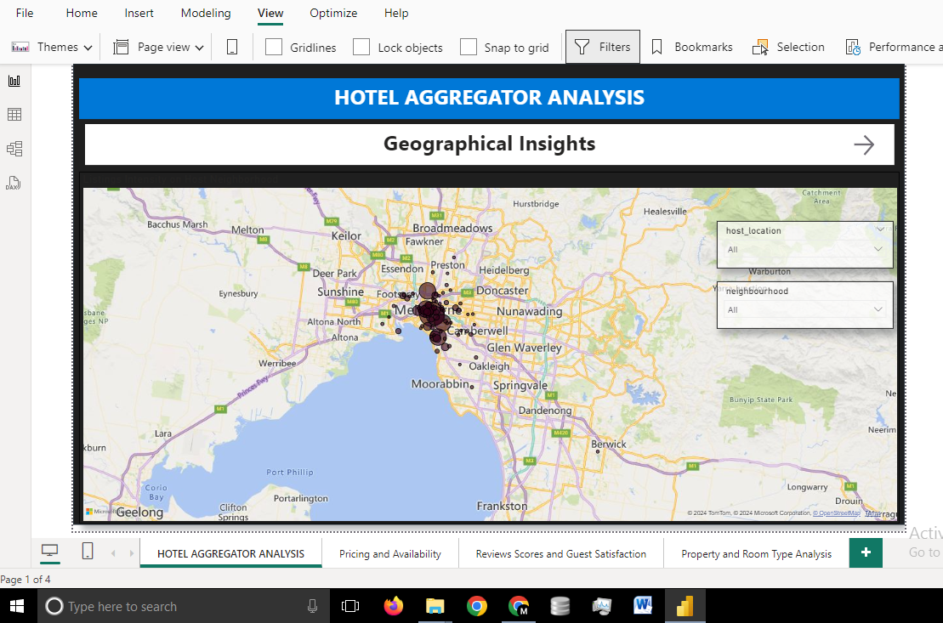
Geographical Insights

Slide 5
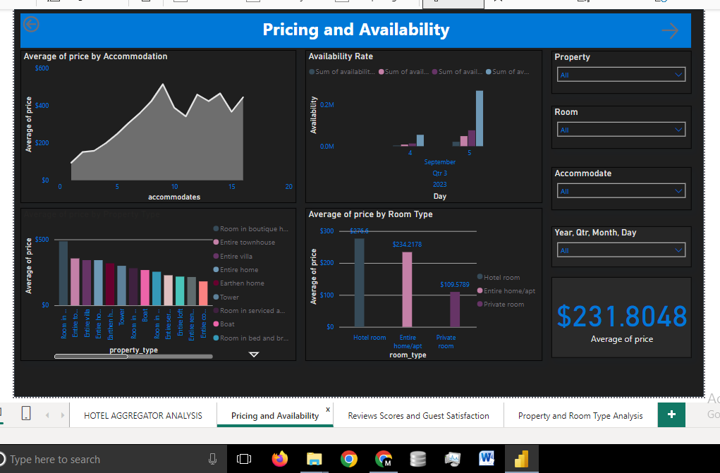
Pricing and Availability Analysis

Slide 6
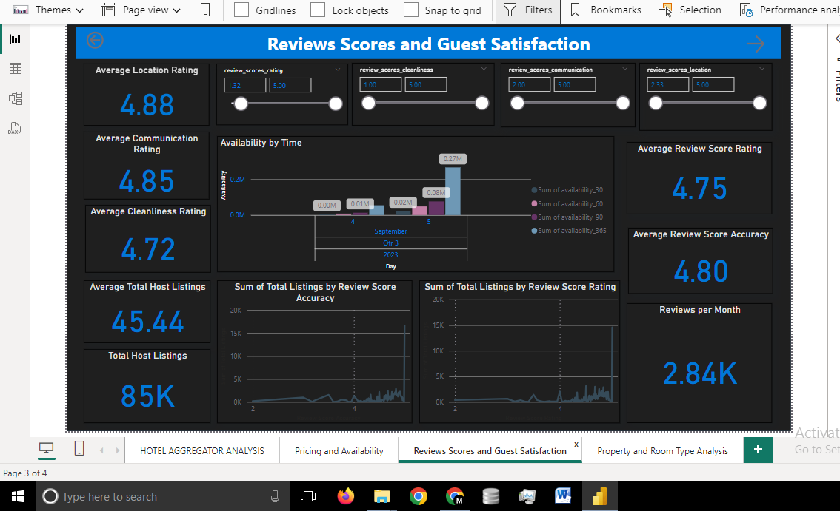
Review Scores and Guest Satisfaction

Slide 7
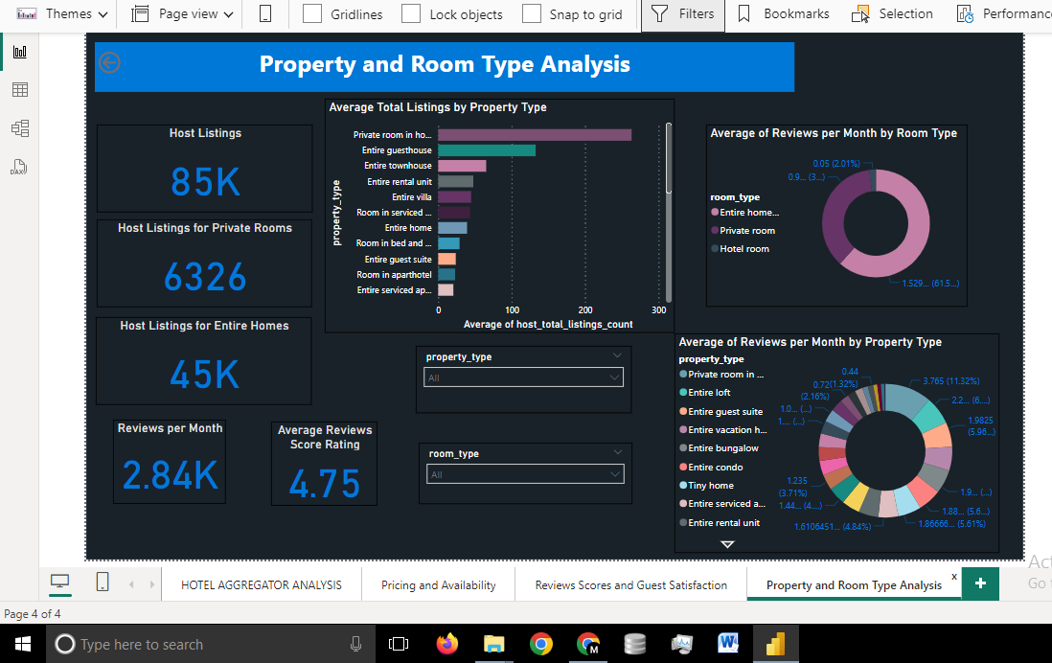
Property and Room Type Analysis

Slide 8
Thank You

